Slide 1

ROBOTIC AUTOMATED EXTERNAL DEFIBRILLATOR AMBULANCE FOR EMERGENCY MEDICAL SERVICE IN SMART CITIES
GUIDE :
Mr. C.THIYAGARAJAN
ASSISTANT PROESSOR,
DEPARTMENT OF CSE,
PANIMALAR ENGINEERING COLLEGE
SUBMITTED BY:
DINESH K R (211417104054)
HAZARATH SHRAVAN M R (211417104084)
FAZIL M (211417104063)

Slide 2
INTRODUCTION
Traffic signals in India has a fixed time period to switch the signals. No changes for emergency vehicles.
This makes the patient in ambulance to sever stage. To deal with this problem we designed this system.
In this paper, we propose an IOT-based system for patients with the risk of heart attack and uneven body temperature, high pulse rate.
If the condition is critical an alert notification will be sent to the hospital monitoring database.
This system consists of various sensors which collects the patient's information and transmit those information to the server via IOT board.

Slide 3
LITERATURE SURVEY
Heading | DESCRIPTION
Development of Monitoring and Health Service Information System to Support Smart Health on Android Platform(2018) | This research proposes a design of health monitoring system named Mooble ,a system to monitor patient health condition and to prevent diseases as early as possible. Mooble consists of three subsystems: web application, database and API design, and mobile application on android platform.
An Android Application for Geolocation Based Health Monitoring, Consultancy and Alarm System (2018) | In this study they benefit the facilities provided by mobile technology and propose a geolocation-based heart rate monitoring system.
Remote health, activity, and asset monitoring with wireless sensor networks(2017) | They propose a system that employs a wireless mesh sensor network to provide the communication backbone for stationary and wearable sensors.

Slide 4
PROBLEM STATEMENT
The traffic condition in India effect emergency services like Ambulance and Fire engine. Time is an important factor in case of emergencies; hence we are proposing a system which makes the patient gets right time treatment in ambulance.
According to research conducted by global consultancy firm, traffic in peak hours in major four cities - Delhi, Bengaluru, Chennai, Kolkata costs the economy Rs 1.47 lakh crore per annum
Because of this delay in ambulance service, patient may lose his life and number of these scenarios are increasing day by day.
When emergency vehicles are stuck in heavy traffic and cars are unable to pull over. In that time, the patients gets into dangerous stage. In ambulance the care taker have no idea treat the patient in sever stage it makes patient die or dangerous stage.This paper proposes a solution to make such services easily available to those in need.

Slide 5
TECHNOLOGY STACK
Software:
KEIL UVISION
EMBEDDED C
Hardware:
ATMEL Microcontroller
ECG Sensor, IR Sensor, HeartBeat Sensor
Global Positioning System (GPS)
Global System for Mobile Communication (GSM Module)
Liquid Crystal Display (LCD)
Relay

Slide 6
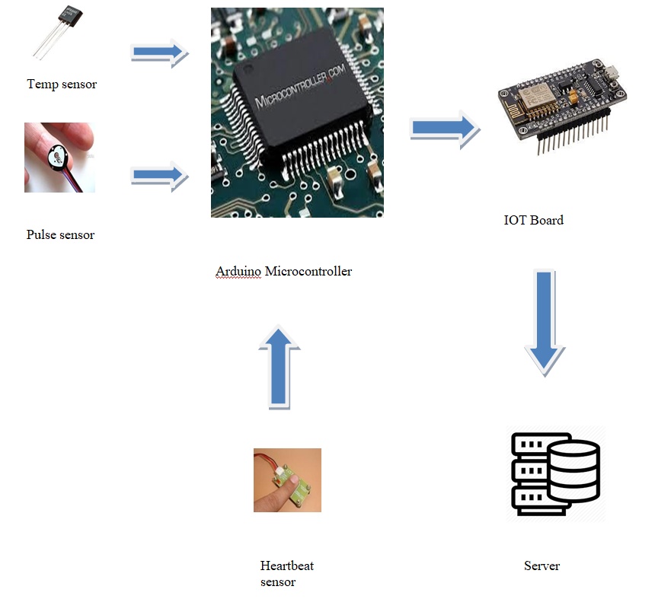
SYSTEM ARCHITECTURE

Slide 7
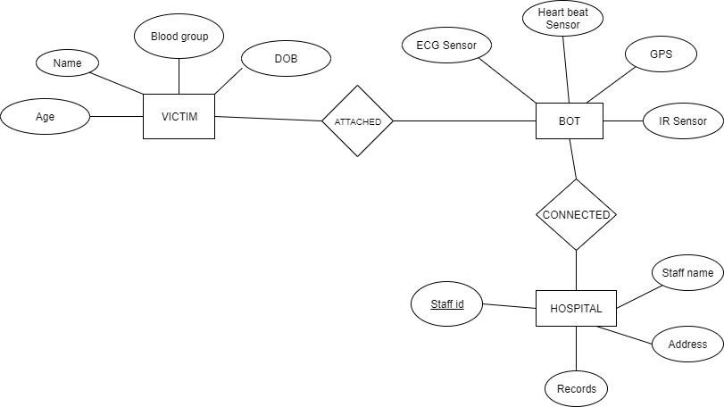
SYSTEM DESIGN
ER Diagram

Slide 8
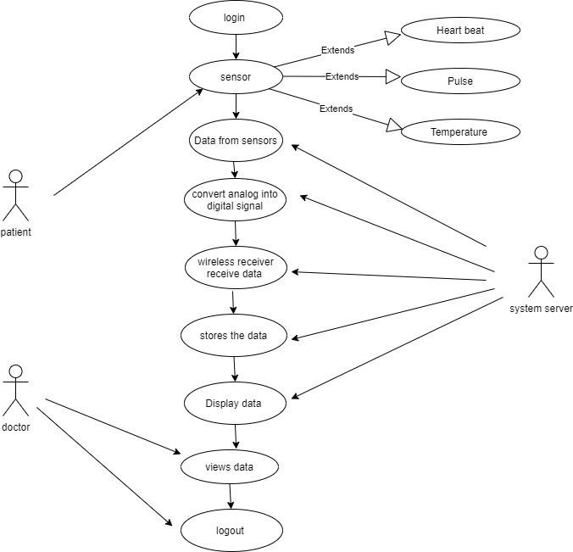
UseCase Diagram

Slide 9
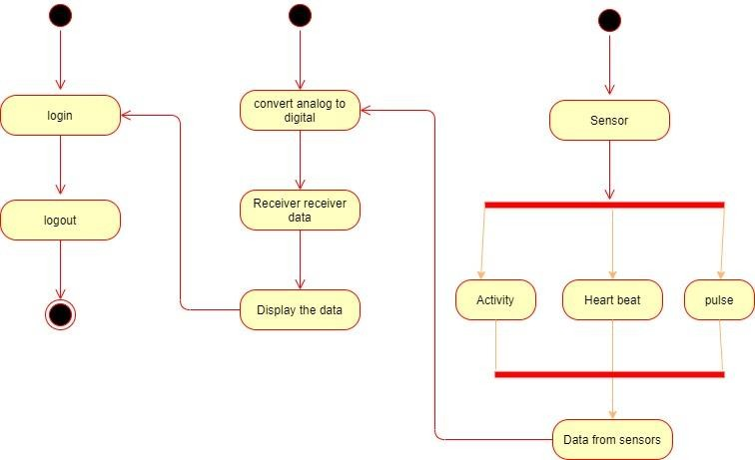
Activity Diagram

Slide 10
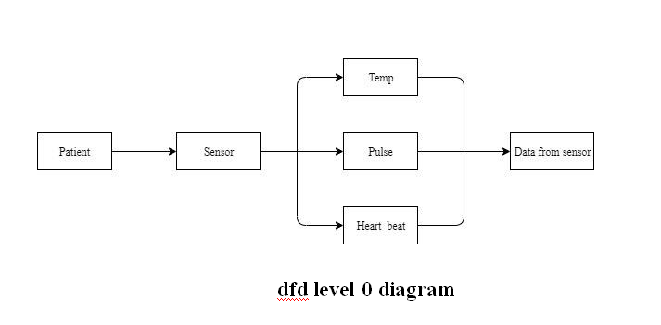
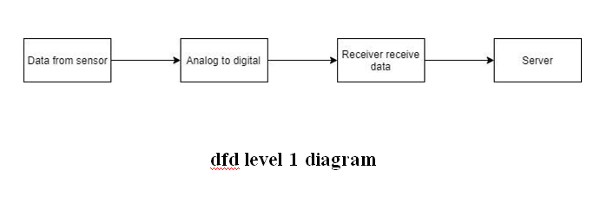
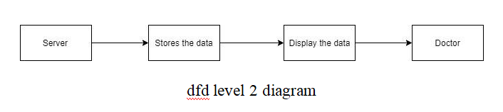
DFD Diagram

Slide 11
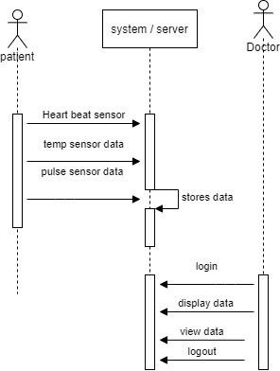
Sequence Diagram

Slide 12
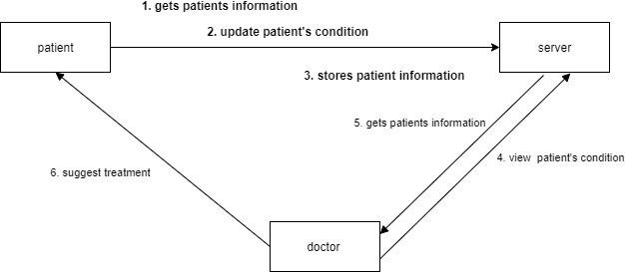
Collaboration Diagram

Slide 13
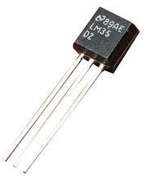
MODULE DESCRIPTION
Temperature Sensor :
The LM35 series are precision integrated-circuit temperature devices with an output voltage linearly- proportional to the Centigrade temperature.
The LM35 device is rated to operate over a −55°C to 150°C temperature range, while the LM35C device is rated for a −40°C to 110°C range (−10° with improved accuracy).

Slide 14
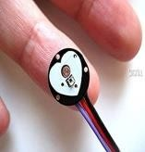
Pulse Sensor :
Pulse Sensor is a well-designed plug-and-play heart-rate sensor for Arduino.
The sensor clips onto a fingertip or earlobe and plugs right into Arduino with some jumper cables. It also includes an open-source monitoring app that graphs your pulse in real time.
Heart Beat Sensor :
Heartbeat Sensor is an electronic device that is used to measure the heart rate i.e. speed of the heartbeat.
We can find the Principle of Heartbeat Sensor, working of the Heartbeat Sensor and Arduino based Heart Rate Monitoring System using a practical heartbeat Sensor.

Slide 15
IR Sensor :
An infrared sensor is an electronic gadget, that transmits so as to detect a few parts of the environment.
An IR sensor can gauge the warmth of an article just as identifies the movement.
These sorts of sensors quantifies just infrared radiation, instead of producing it that is called as a detached IR sensor.
Relay :
A relay is a electromagnetic switch, It is used in application to turn on and of a circuit by low power signal 24V, or several circuits must be controlled by one signal.

Slide 16
GPS Module :
A GPS navigation device, GPS receiver, or simply GPS is a device that is capable of receiving information from GPS satellites and then to calculate the device's geographical position. Using suitable software, the device may display the position on a map, and it may offer directions. The Global Positioning System (GPS) is a global navigation satellite system made up of a network of a minimum of 24, but currently 30, satellites placed into orbit by the U.S. Department of Defense.
GSM Module :
GSM (Global System for Mobile communications) is a standard developed by the European Telecommunications Standards Institute (ETSI) to describe the protocols for second-generation (2G) digital cellular networks used by mobile devices such as tablets.
It was first deployed in Finland in December 1991.
As of 2014, it has become the global standard for mobile communications with over 90% market share, operating in over 193 countries and territories.

Slide 17
LCD Display :
LCD (liquid crystal display) is the technology used for displays in notebook and other smaller computers.
Like light-emitting diode (LED) and gas-plasma technologies, LCDs allow displays to be much thinner than cathode ray tube (CRT) technology.
LCDs consume much less power than LED and gas-display displays because they work on the principle of blocking light rather than emitting it.
ATMEL Microcontroller :
AVR is a family of microcontrollers developed since 1996 by Atmel, acquired by Microchip Technology in 2016.
These are modified Harvard architecture 8-bit RISC single-chip microcontrollers.
AVR was one of the first microcontroller families to use on-chip flash memory for program storage, as opposed to one-time programmable ROM, EPROM, or EEPROM used by other microcontrollers at the time.

Slide 18
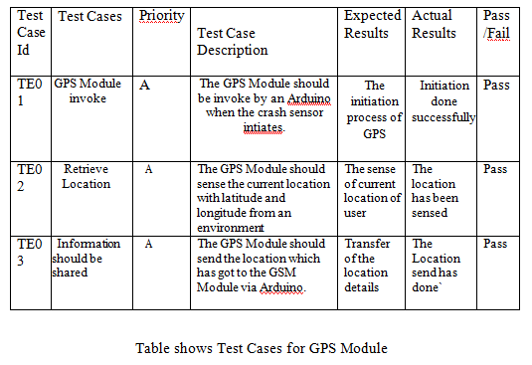
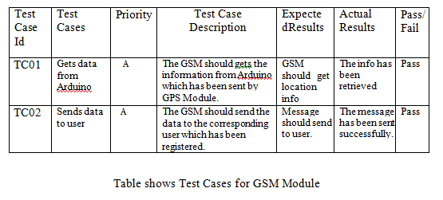
PERFORMANCE EVALUATION
TestCases For GPS and GSM Module

Slide 19
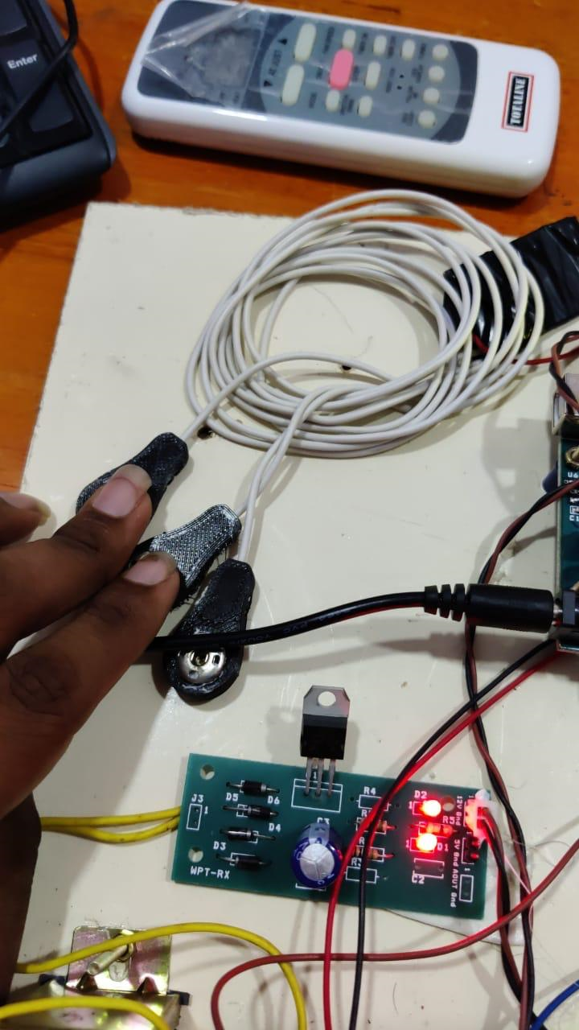
SCREENSHOTS
ECG Sensor

Slide 20
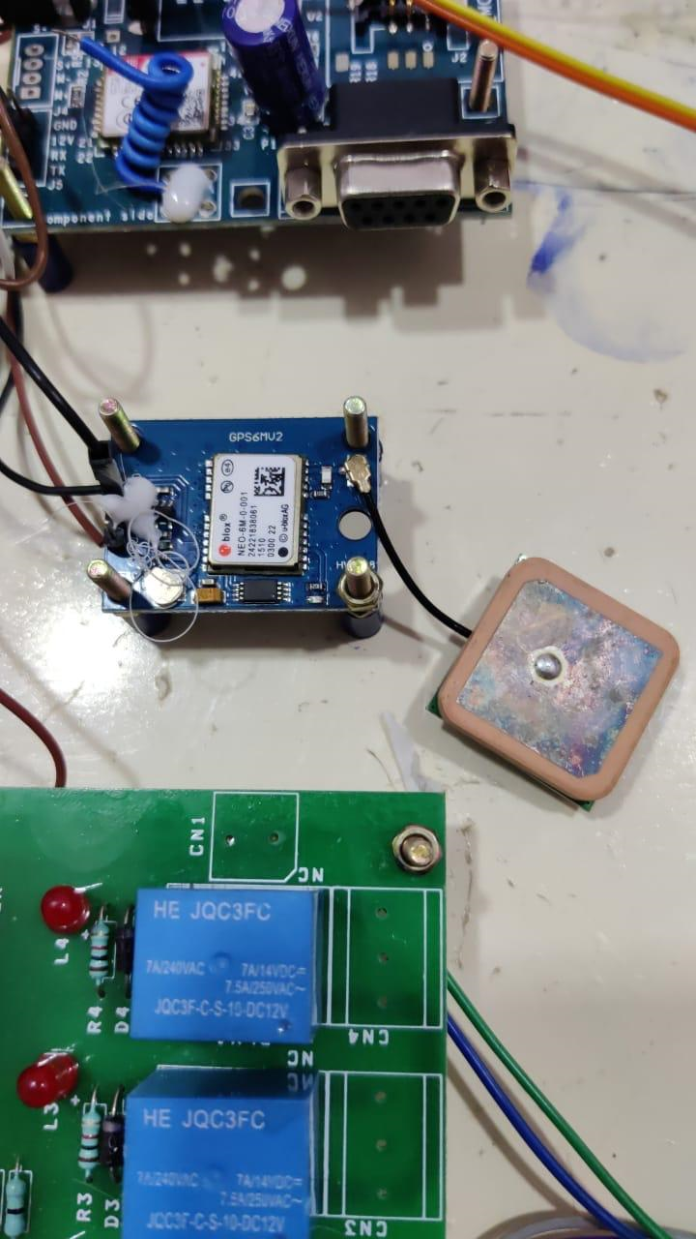
GPRS

Slide 21
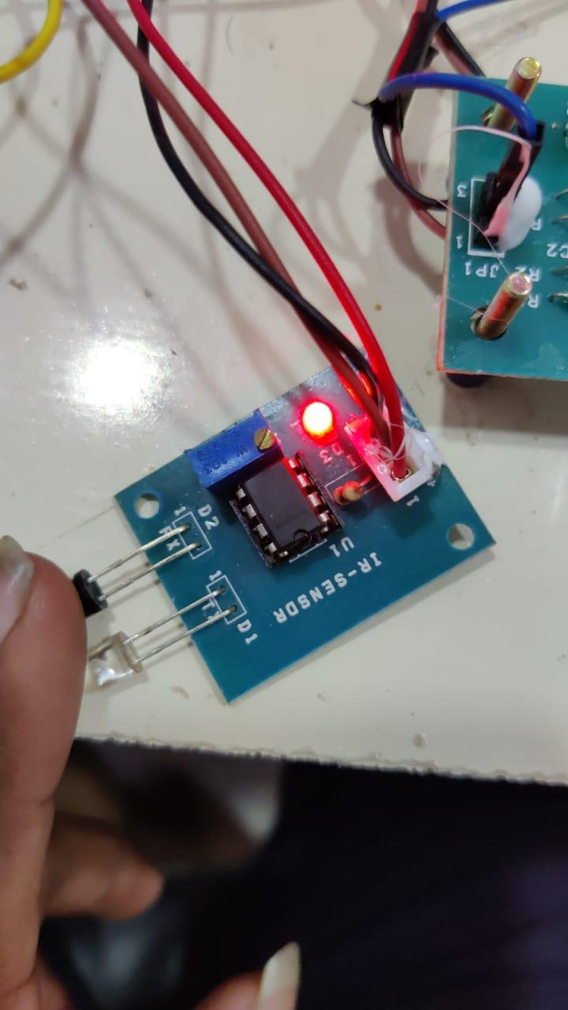
IR Sensor

Slide 22
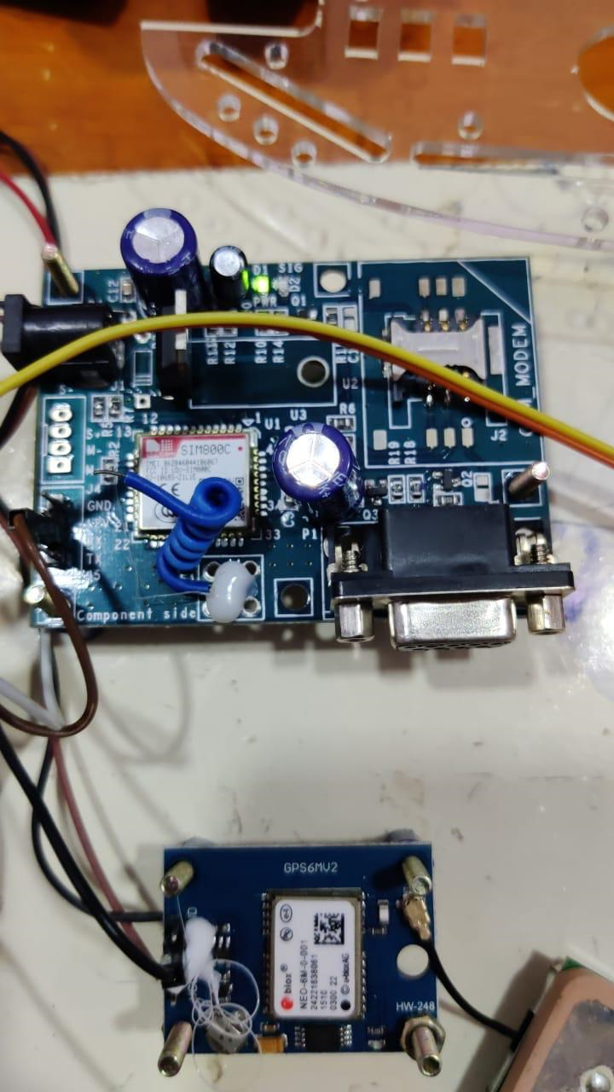
GSM

Slide 23
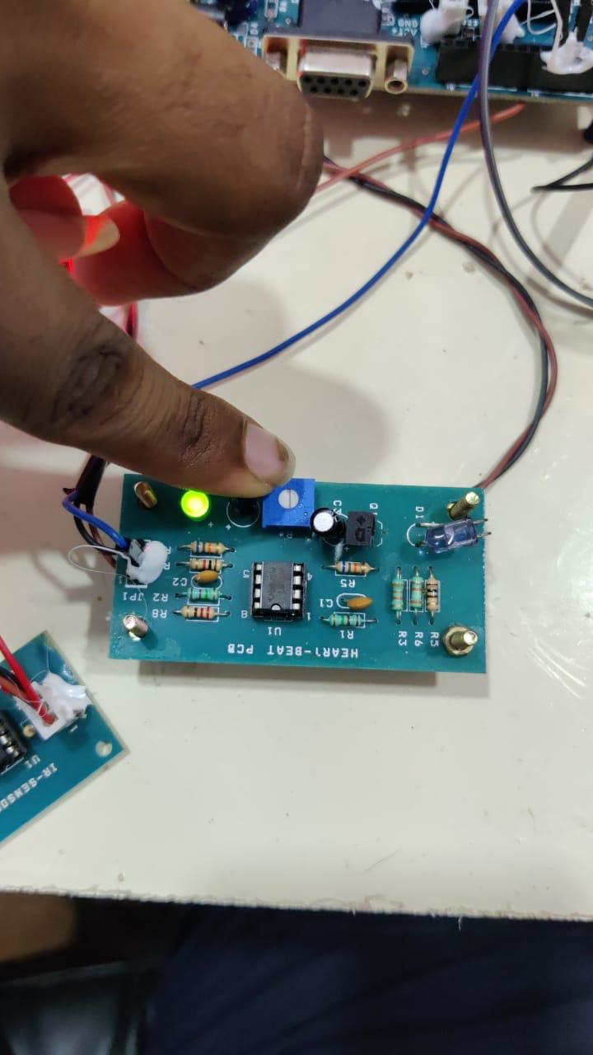
HeartBeat Sensor

Slide 24
CONCLUSION
In this paper, we propose an IOT-based system for patients with the risk of heart attack and uneven body temperature or any other sever condition in ambulance. If the condition is critical the information about the patient will be sent to the hospital database. This paper proposes a system to update patient data to hospital servers for analyzing. The doctor can view patient details, before the patient entering in to the hospital. We approach a system which is used to connect the ambulance and hospitals.
FUTURE ENHANCEMENT
Our future work will be integrated with aadhar card and patients details. It will help to doctors to analyze the doctor for past history of the patients. The processes will include the creating a data base for every patients.

Slide 25
REFERENCES
[1] H. Ning et al.,“From Internet to smart world,” IEEE Access, vol. 3, pp. 1994-1999, Oct. 2015..
[2] R. Jalali, K.El-khatib, and C. McGregor, “Smart city architecture for community level services through the Internet of Things,” in Proc. IEEE 18th Int. Conf. Intell.Next Generat. Netw. (ICIN), Feb. 2015, pp. 108-113
[3] M. Arif, H.Samani, C.-Y. Yang, and Y.-Y. Chen, “Adaptation of mobile robots to intelligent vehicles,” in Software Engineering and Service Science (ICSESS), 2013 4th IEEE International Conference on. IEEE,2013.
[4] F. Matsuno and S. Tadokoro, “Rescue robots and systems in japan in Robotics and Biomimetics, 2004. ROBIO 2004. IEEE International Conference on. IEEE, 2004.
[5] C.-P. Lam, C.-T. Chou, K.-H. Chiang and L.-C.Fu, “Human-centered robot navigation towards a harmoniously human–robot coexisting environment, ”Robotics, IEEE Transactions on, vol. 27, no. 1, pp. 99– 112,2011.

Slide 26


Thank You!

